Slide 1
Lecture 4: BA at the Analytical Level (part 2)
Prof. Mike Boyle
Department of Operations and Information Systems
University of Utah

Slide 2
Ingredients for an Effective Analyst
Understanding reporting vs. analysis
Individual analyst attributes
Analytical environment
Common analytical methodologies, tools and techniques

Slide 3
Ingredients (cont’d): Analytical Methodologies, Techniques and Tools
From the text: “An analyst only derives a fraction of the knowledge that is potential if he fails to use the correct analytical methodology.”
Incorrect interpretations from under-skilled analysts may result in poor decisions
Inefficient use of systems or analytical methodologies may reduce the potential benefits from various analytics investments

Slide 4
Ingredients (cont’d): Analytical Methodologies, Techniques and Tools
Common analytical methodologies, tools and techniques
Use of analysis frameworks
Use of context throughout analysis project
Basic numerical analysis techniques
Basic visual analysis techniques
Basic process/business analysis techniques
Data Science techniques

Slide 5
Ingredients (cont’d): Analytical Methodologies, Techniques and Tools
Use of high-level analysis framework. E.g.:
Scientific Method: 1. Make observations > 2. Formulate Hypotheses > 3. Gather Evidence > 4. Draw Conclusions
Data Science project phases: 1. Define project goal > 2. Collect and manage data > 3. Build model > 4. Evaluate and critique model > 5. Present results and documentation > 6. Deploy and maintain model
* Source: Zumel N., Mount J., “Practical Data Science with R” (2014)

Slide 6
Ingredients (cont’d): Analytical Methodologies, Techniques and Tools
Use of several contexts throughout the analysis project:
Internally available sources:
Company/Department
Value-creating primary process and other processes
Customers
Externally available sources:
Industry
Competitors
Customers (again)

Slide 7
Ingredients (cont’d): Analytical Methodologies, Techniques and Tools
Basic numerical analysis techniques
Percentage of total (i.e. ratios)
Percentage/absolute change period-over-period
Relationships to targets (internal) and benchmarks (external)
Mean, median, min, max, quantiles, variance
Distributions, number of observations, outliers

Slide 8
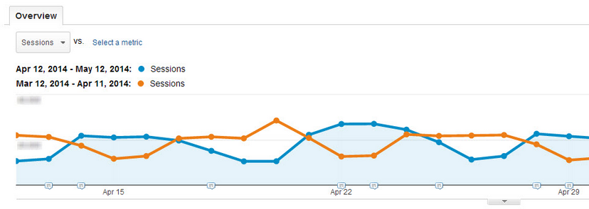
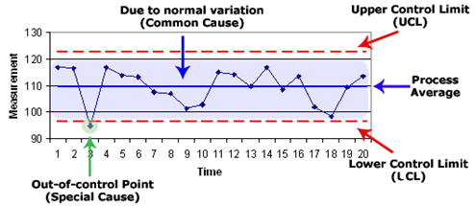
Ingredients (cont’d): Analytical Methodologies, Techniques and Tools
Basic visual analysis techniques
Trend analysis
Overlays: E.g. different:
time periods
Segments (e.g. of customers)
Control limits
Moving averages (no image)

Slide 9
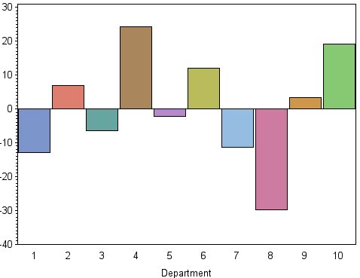
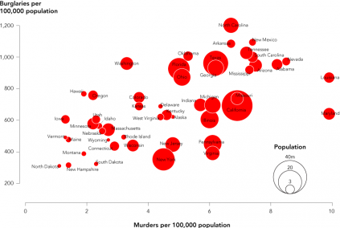
Ingredients (cont’d): Analytical Methodologies, Techniques and Tools
Basic visual analysis techniques
Deviation charts
Bubble charts
Scatter plots (no image)

Slide 10
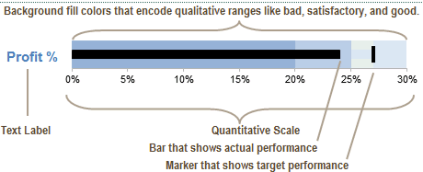
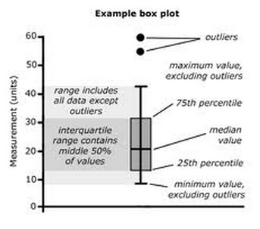
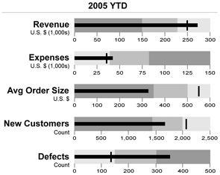
Ingredients (cont’d): Analytical Methodologies, Techniques and Tools
Basic visual analysis techniques
Box plots
Bullet charts
Bar charts (no image)

Slide 11
Ingredients (cont’d): Analytical Methodologies, Techniques and Tools
Business/process analysis techniques
A3 report
Cause-and-effect analysis
5-whys analysis
Pareto analysis

Slide 12
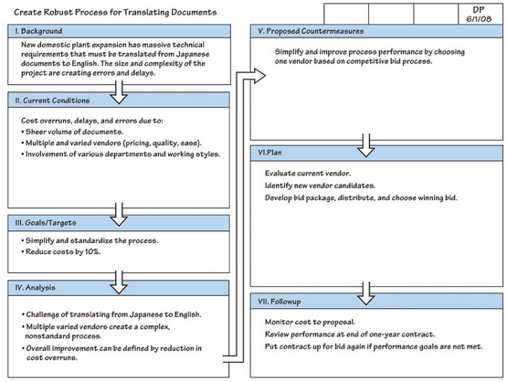
Ingredients (cont’d): Analytical Methodologies, Techniques and Tools
A3 Report
Used to organize process improvement initiative

Slide 13
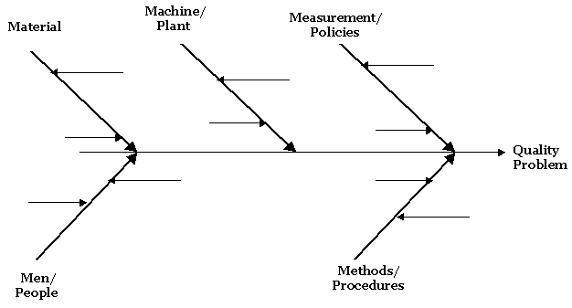
Ingredients (cont’d): Analytical Methodologies, Techniques and Tools
Cause-and-effect analysis diagram
Note the 5 M’s

Slide 14
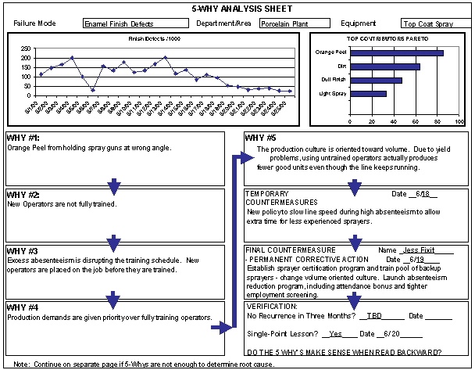
Ingredients (cont’d): Analytical Methodologies, Techniques and Tools
5-whys analysis

Slide 15
Ingredients (cont’d): Analytical Methodologies, Techniques and Tools
Pareto analysis steps:
List problems
Identify root cause for each problem
Score problems
Group problems together by root cause
Add scores up for each group and sort in descending order
Act and measure

Slide 16
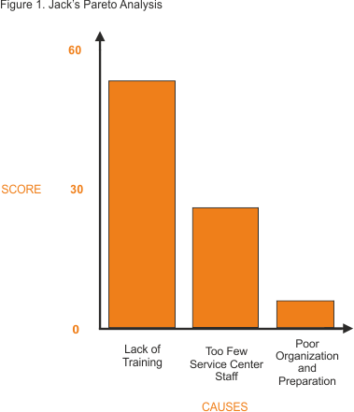
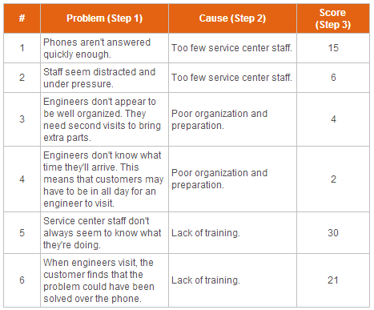
Ingredients (cont’d): Analytical Methodologies, Techniques and Tools
Pareto Analysis example
Source: http://www.mindtools.com/pages/article/newTED_01.htm, last accessed, 2013/04/18

Slide 17
Ingredients (cont’d): Analytical Methodologies, Techniques and Tools
Data Science Techniques

Slide 18
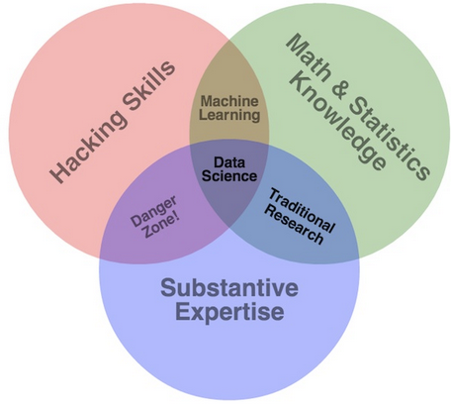
Data Science

Slide 19
Terminology: Data Science
Data Science: “…refers to an emerging area of work concerned with the collection, preparation, analysis, visualization, management and preservation of large collections of information”*
Data Scientist: Person who is better at statistics than any software engineer and better at software engineering than any statistician.**
Statistics: the study of the collection, organization, analysis, interpretation and presentation of data ***
* Jeffrey Stanton, Syracuse University School of Information Studies
** Josh Wills, https://twitter.com/josh_wills/status/198093512149958656, accesses 2014/08/25
*** Source: http://www.wikipedia.org, last accessed, 2013/09/18

Slide 20
Terminology: Data Science
Data Mining: the computational process of discovering patterns in large data sets involving methods at the intersection of artificial intelligence, machine learning, statistics, and database systems. *
Supervised/Directed/Targeted Data Mining: Data Mining with a target variable (e.g. Neural Network)
Unsupervised/Undirected/Exploratory Data Mining: Data Mining without a target variable. The objective is to find patterns in the data. (e.g. Clustering)
* Source: http://www.wikipedia.org, last accessed, 2013/09/18

Slide 21
Terminology: Data Science (cont’d)
Data-Driven Methodology: Analytics approach where model building (training) and evaluation (testing) are done on separate data sets
Hypothesis-Driven Methodology: Analytics approach where evaluation is done using theory from Statistics
Predictive Analytics/Modeling: Analytics approach where test (evaluation) data is from a time period in the future relative to the training (model building) data. The objective is to use these models on unseen data to predict future outcomes.
Descriptive Analytics/Modeling: Analytics approach where the test data and the training data are taken from overlapping time periods. The objective is to describe the past in terms of the model attributes (i.e. input variables).

Slide 22
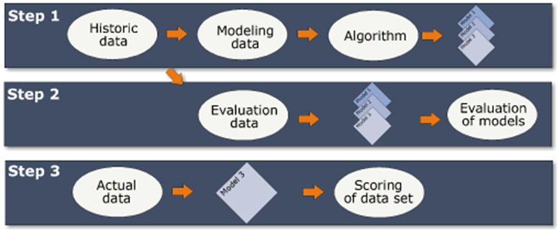
Data Mining Process
Step 1: Build several competing models on training (above == “historic”) data
Step 2: Evaluate candidate models on test (above == “evaluation” data (i.e. preferably out of sample from training data)
Step 3: Select best model(s) and operationalize (i.e. apply to actual data and act)

Slide 23
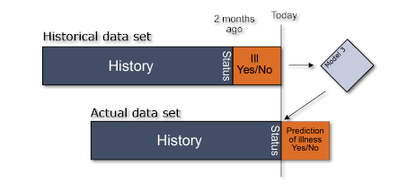
Predictive Analytics Process
Step 1 example: Using 5 weeks of historical data build a model that will predict the likelihood of being ill in the 5th week given the previous 4 weeks of data.
Step 2 example: Using the predictive model above, take the last 4 weeks of data relative to today and predict the likelihood of being ill in this upcoming week.
Build predictive model on historical data separated into time periods t and t – 1
Apply predictive model on data up until time t to predict outcomes in time t + 1

Slide 24
Descriptive vs. Predictive Analytics
Descriptive Analytics
Predictive Analytics
Target Variable and Model Attributes are both from time t
Target Variable (e.g. y) is from time t whereas the Model Attributes (e.g. x matrix) are from time t - 1

Slide 25
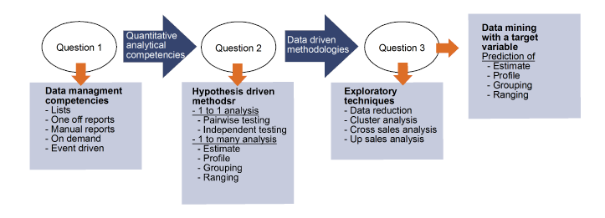
From the Text: A Process for Choosing an Analytical Approach

Slide 26
From the Text: A Process for Choosing an Analytical Approach (cont’d)
Question 1: “Determine with the process owner whether the quantitative analytical competencies, or the data manager and report developer competencies are required.”

Slide 27
From the Text: A Process for Choosing an Analytical Approach (cont’d)
Question 2: “Determine whether hypothesis-driven analytics, or data-driven analytics can be expected to yield the best decision support.”

Slide 28
From the Text: A Process for Choosing an Analytical Approach (cont’d)
Question 2: Hypothesis-driven vs. Data-driven?
Hypothesis-driven when:
Smaller amounts of low-complexity/low-detail data
Correlation and/or single/small multi-variable analysis
Theory to support analysis (e.g. from economics)
Scientific context (repeatable)
Data-driven when:
Larger amounts and/or high-complexity/high-detail data
Out-of-sample performance is critical as compared to theoretical quality of models
Business context (“sort of” repeatable is okay)

Slide 29
From the Text: A Process for Choosing an Analytical Approach (cont’d)
Question 3: “Determine whether the data-driven method has the objective of examining the correlation between one given independent variable and a large number of others or whether the objective is to identify different kinds of structures in the data.”

Slide 30
Choosing an Analytical Approach: Statsoft Textbook
A great resource for understanding different analytical methods:
http://www.statsoft.com/textbook/
“Statistical Advisor” wizard that guides users to effective analytical approaches
http://www.statsoft.com/Textbook/Statistical-Advisor

Slide 31
Descriptive Statistical Methods, Lists and Reports
Types of Reports:
Ad Hoc Reports
Manually Updated Reports
Automated Reports: On Demand
Automated Reports: Event Driven

Slide 32
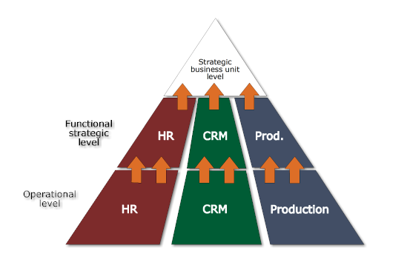
Descriptive Statistical Methods, Lists and Reports (cont’d)
Reporting Architecture should align with the Organizational Strategy
Similar to requirement for Information Strategy to align with Organizational Strategy
Note: Important to periodically review Reporting Architecture and update it to ensure alignment. Note that many of the “updates” include deprecating reports that are no longer relevant to the Organizational Strategy.

Slide 33
Hypothesis-driven Methods
Hypothesis Testing – E.g. t-test
Correlation Analysis – E.g. Pearson Correlation
Sampling and Power Analysis – E.g. determine sample size to observe an effect
Analysis of Variance (ANOVA) – E.g. t-tests for multiple variables
Linear Regression Analysis
Continuous dependent variable
Single and multiple independent variables
Logistic Regression Analysis
Binary dependent variable
Single and multiple independent variables

Slide 34
Data-driven Methods
Data-mining with a target variable (supervised)
Linear/Non-linear Regression
Classification and Regression Trees (Decision Trees)
Boosting and Additive Methods
Neural Networks
Support Vector Machines
Random Forests
Ensembles

Slide 35
Data-driven Methods (cont’d)
Data-mining without a target variable (unsupervised)
Association Rules
Clustering
Principal Component Analysis
Factor Analysis

Slide 36
When NOT to Apply Analytics
Consider alternatives to analytics when:
Is there limited time? == Yes
Is there a precedent? == No
Does the decision-maker have considerable experience? == Yes
Might history misleading? == Yes
Can enough of the relevant variables be measured/collected? == No
Source: Davenport et al, “Analytics at Work” Harvard Business Press, 2010, pp. 10 - 12

Slide 37
Why/When/Where to Apply Analytics
Consider:
Can the negatively-impacting cognitive biases be countered with an analytic solution? == Yes
Is there a high value in automating the decision(s)? == Yes
Do any data quality issues pre-exist or stem from the manual decision process(es)? == Yes
E.g. Input data for the decision
E.g. Data entry for the decision

Slide 38
Why/When/Where to Apply Analytics (cont’d)
Consider applying analytics for processes that are:*
Data and/or Information rich
Asset-intensive/Labor-intensive
Dependent on speed/timing
Dependent on consistency and/or control
Dependent on distributed decision-making
Low success rate/high variation
*Source: Davenport et al, “Analytics at Work” Harvard Business Press, 2010, p. 80

Slide 39
Appendix

